Slide 1

School of Coumputing Science and Engineering
Course Code: BCS01T1003 Course Name: Programming for Problem Solving – C
UNIT 4
Structure
Difference and Application, Nested structure,
and Self-referential structure
Faculty Name: Prof. (Dr.) Sansar Singh Chauhan Program Name: B. Tech. AI & DS

Slide 2
Outline
Structure:
Difference and Application,
Nested structure,
Self-referential structure
Program Name: B. Tech. AI & DS

Slide 3
Structure: Definition and Declaration
Structure Definition
struct card
{ char *face; char *suit; };
Structure Declaration
struct card aCard, deck[ 52 ], *cardPtr;
Program Name: B. Tech. AI & DS

Slide 4
Structure: Accessing Structure Members
Two operators are used to access members of structures:
The structure member operator (.)—also called the dot operator—and
The structure pointer operator (->)—also called the arrow operator.
struct card
{ char *face; char *suit; };
struct card aCard = { "Three", "Hearts" }, deck[ 52 ], *cardPtr;
cardPtr=&aCard;
printf( "%s", aCard.suit ); /* displays Hearts */
printf( "%s", cardPtr->suit ); /* displays Hearts */
Program Name: B. Tech. AI & DS

Slide 5
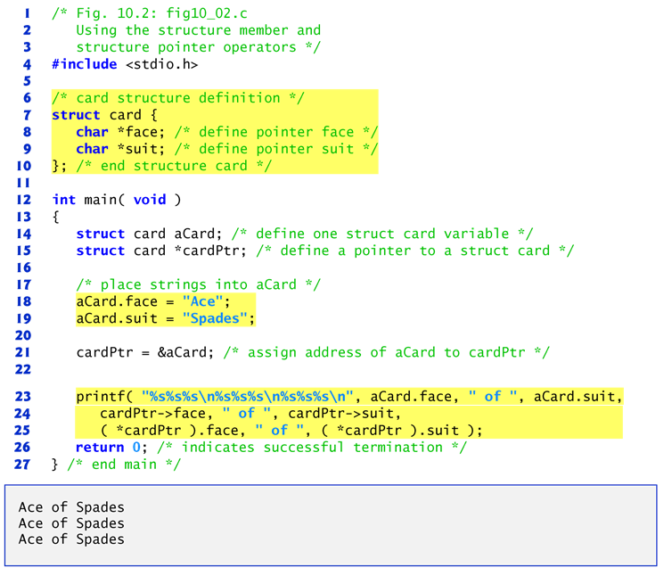
Program
Program Name: B. Tech. AI & DS

Slide 6
Structure: Applications
Structures allow to store different data types information inside it at contiguous memory location.
It is a collection of different data types which are at contiguous memory locations.
If we want to represent too many information(too many variables) of same data type as an single entity then we go for Array.
But if we want to represent too many information(too many variables) of different different data types as an single entity then we go for Structure.
Program Name: B. Tech. AI & DS

Slide 7
Structure: Nested Structure
A structure can be nested inside another structure. In other words, the members of a structure can be of any other type including structure. Here is the syntax to create nested structures.
struct address
{
char city[20];
int pin;
char phone[14];
};
struct employee
{
char name[20];
struct address add;
}emp;
struct employee
{
char name[20];
struct address
{
char city[20];
int pin;
char phone[14];
}add;
} emp;
Program Name: B. Tech. AI & DS

Slide 8
Structure: Nested Structure
Structures are derived data types—they are constructed using objects of other types.
Consider the following structure definition:
struct card { char *face; char *suit; };
Keyword struct introduces the structure definition.
The identifier card is the structure tag, which names
the structure definition and is used with the keyword
struct to declare variables of the structure type.
Program Name: B. Tech. AI & DS

Slide 9
Accessing nested structure member
struct student
{
struct person
{
char name[20];
int age;
char dob[10];
} p ;
int rollno;
float marks;
} stu;
stu.p.name - refers to the name of the person stu.p.age - refers to the age of the person stu.p.dob - refers to the date of birth of the person
Program Name: B. Tech. AI & DS

Slide 10
Important point
Nesting of structure within itself is now allowed. For example:
struct citizen
{
char name[50];
char address[100];
int age;
int ssn;
struct citizen relative; // invalid
} ;
Program Name: B. Tech. AI & DS

Slide 11
Initializing nested Structures
struct person
{
char name[20];
int age;
char dob[10];
};
struct student
{
struct person info;
int rollno;
float marks[10];
};
struct student student_1 = {
{"Adam", 25, 1990},
101,
90
};
Program Name: B. Tech. AI & DS

Slide 12
Program demonstrates how we can use nested structures.
#include<stdio.h>
struct person
{
char name[20];
int age;
char dob[10];
};
struct student
{
struct person info;
int roll_no;
float marks;
};
int main()
{
struct student s1;
printf("Details of student: \n\n");
printf("Enter name: ");
scanf("%s", s1.info.name);
printf("Enter age: ");
scanf("%d", &s1.info.age);
printf("Enter dob: ");
scanf("%s", s1.info.dob);
printf("Enter roll no: ");
scanf("%d", &s1.roll_no);
printf("Enter marks: ");
scanf("%f", &s1.marks);
printf("\n*******************************\n\n");
printf("Name: %s\n", s1.info.name);
printf("Age: %d\n", s1.info.age);
printf("DOB: %s\n", s1.info.dob);
printf("Roll no: %d\n", s1.roll_no);
printf("Marks: %.2f\n", s1.marks);
// signal to operating system program ran fine
return 0;
}
Program Name: B. Tech. AI & DS

Slide 13
Sample Output
Details of student:
Enter name: Amit
Enter age: 27
Enter dob: 23/4/1990
Enter roll no: 78123
Enter marks: 92
*******************************
Name: Amit
Age: 27
DOB: 23/4/1990
Roll no: 78123
Marks: 92.00
Program Name: B. Tech. AI & DS

Slide 14
Self-referential structure
Self Referential structures are those structures that have one or more pointers which point to the same type of structure, as their member.
struct node
{
int data1;
char data2;
struct node* link;
};
int main()
{
struct node ob;
return 0;
}
Program Name: B. Tech. AI & DS

Slide 15
Types of Self Referential Structures
To help us understand and think about self-referential structures, we use pictures:
data
next
The data
members.
The pointer
member.
Program Name: B. Tech. AI & DS

Slide 16
Example
struct list {
int data;
struct list *next;
}
struct list a, b, c;
a.data = 1; The result of these
b.data = 2; declarations and
c.data = 3; initializations is pictured
below:
a.next = b.next = c.next = NULL;
a
b
c
1
NULL
2
NULL
3
NULL
Program Name: B. Tech. AI & DS

Slide 17
Continuation of Example
a.next = &b;
b.next = &c;
a
b
c
1
2
3
NULL
Now we can use the links to retrieve
data from successive elements.
a.next->data has a value of 2
a.next->next->data has a value of 3
Program Name: B. Tech. AI & DS

Slide 18
Linear Linked Lists
A linked list has a head pointer that addresses the first element of the list.
Then the pointer member in each structure in the list points to a successor structure.
The last structure has its pointer member set to NULL.
Typically, a linked list is created dynamically.
Program Name: B. Tech. AI & DS

Slide 19
References
Reference:
‘C’ The Complete Reference - Herbert Schildt
Programming ANSI C, McGraw-Hill – E.Balagurusamy
The C programming language - Brian Kernighan and Dennis Ritchie
Web Reference –
www.geeksforgeeks.org
http://www.d.umn.edu
http://web2.uwindsor.ca
Program Name: B. Tech. AI & DS

Slide 20
Contact Information
Email-ID
sansar.chauhan@galgotiasuniversity.edu.in
Program Name: B. Tech. AI & DS

Slide 21

Prerequisite
Can we allocate only arrays?
malloc can be used to allocate memory for single variables also
p = (int *) malloc (sizeof(int));
Allocates space for a single int, which can be accessed as *p
Single variable allocations are just special case of array allocations
Array with only one element
Program Name: B. Tech. AI & DS

